Slide 1
Project: “ Red Smart Home”

Slide 2
Team
Dimitris Tagkalos
Eleni Pipeli
Aris Tasios
Vassilis Balioukos
Tasos Zochios

Slide 3
Technologies
User Interface
Angular 7
Business Layer
Spring Boot (Spring Initializr, Maven)
Spring Hibernate (JPA) (Entities, Repositories, Controllers, Services)
Spring REST web services
Data Access Layer
Database
MySQL - Workbench
Git Hub used for Repository and Collaboration

Slide 4
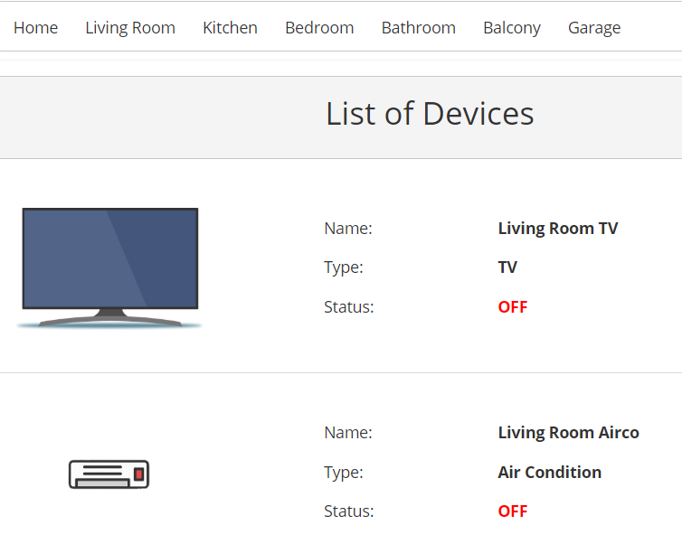
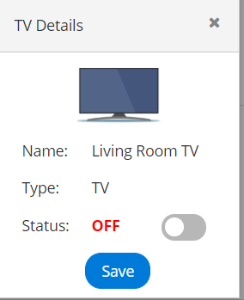
Functionalities
List of Devices per Room
Device Details and Modify Device status

Slide 5
Next Steps
Login and User Authentication
Admin Dashboard (i.e. New User, New Device, Assign device to User)
Behaviors per device type (e.g. increase temp for Air Condition)

Slide 6
Special thanks to Sokratis and Giannis for their support…

Slide 7
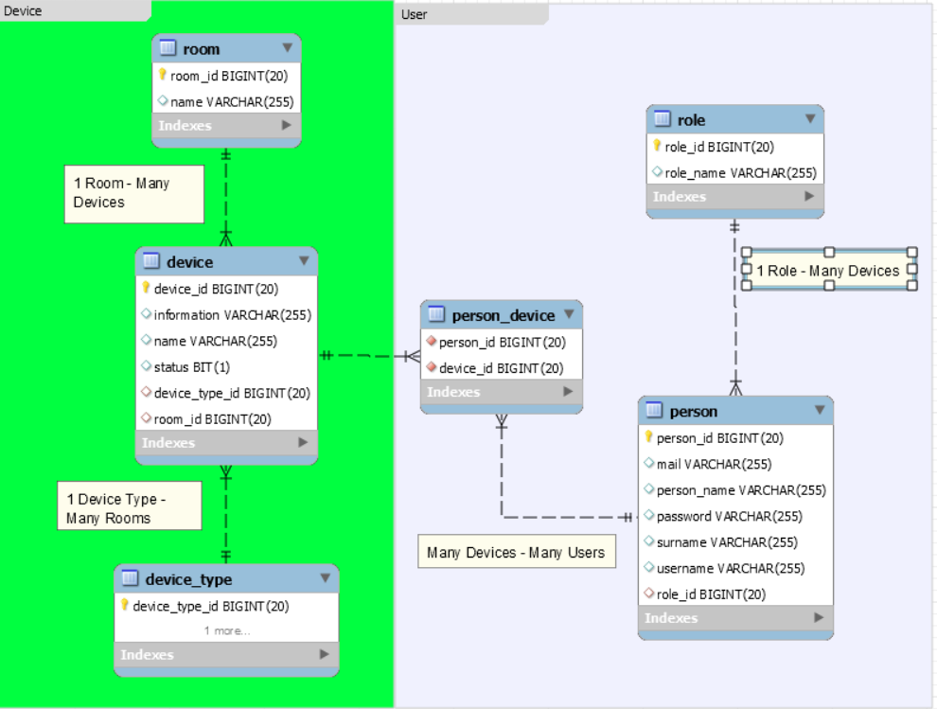
ER Diagram - Relationships

